Slide 1

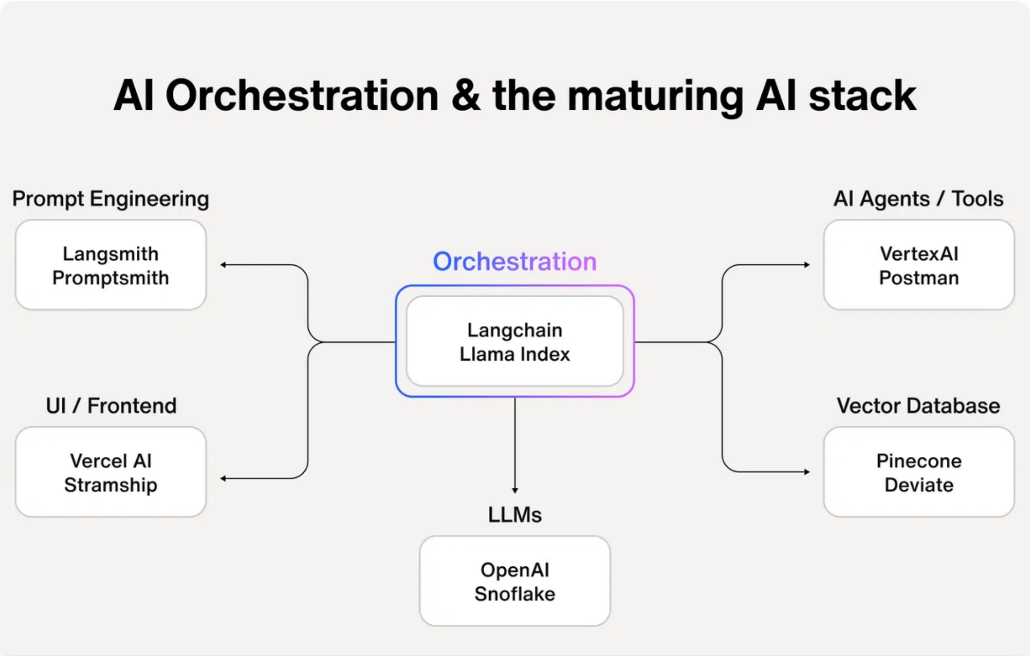



System Overview and Analysis Scope
The
represents a sophisticated approach to personal life automation that demonstrates exceptional potential for transforming individual decision-making capabilities.
Mirador multi-agent AI orchestration system
Analysis Scope
Comprehensive evaluation based on 189 output chains, technical architecture, and implementation analysis
System Maturity
Advanced prototype that has successfully evolved from concept to near-production readiness
Assessment Focus
Mirador orchestrates specialized AI models to provide comprehensive, contextually-aware analysis across multiple life domains
Architecture excellence, content quality, technical implementation, and optimization opportunities

Slide 2

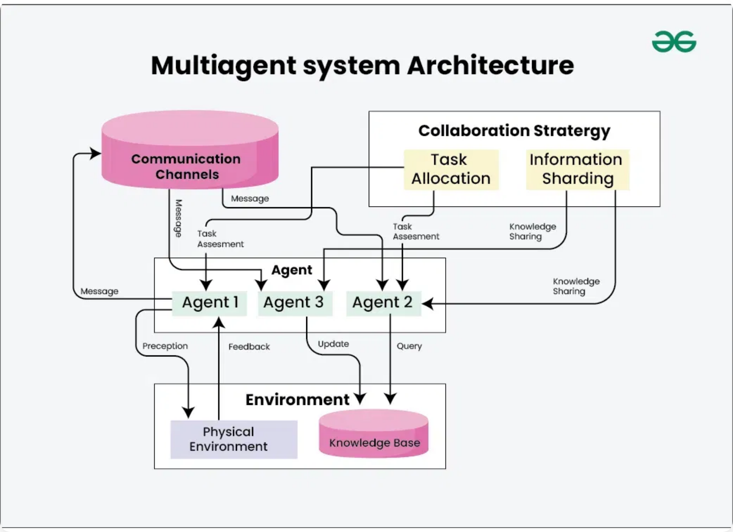




Multi-Agent Architecture Excellence
Mirador's fundamental innovation lies in its
sophisticated multi-agent orchestration approach
that transcends the limitations of single-model AI interactions.
Three-Tier Specialist Architecture
Domain Specialist → Contextual Specialist → Synthesizer pattern enables comprehensive analysis across multiple domains
Progressive Context Building
Each model builds upon previous analysis while adding unique value, creating a cumulative intelligence effect
Intelligent Chain Selection
Automatic query routing to appropriate specialist chains based on sophisticated content classification
Technical Implementation
Mirador's multi-agent architecture enables collaborative intelligence through specialized model coordination
Python-based orchestration engine with robust error handling, comprehensive logging, and sophisticated state management

Slide 3


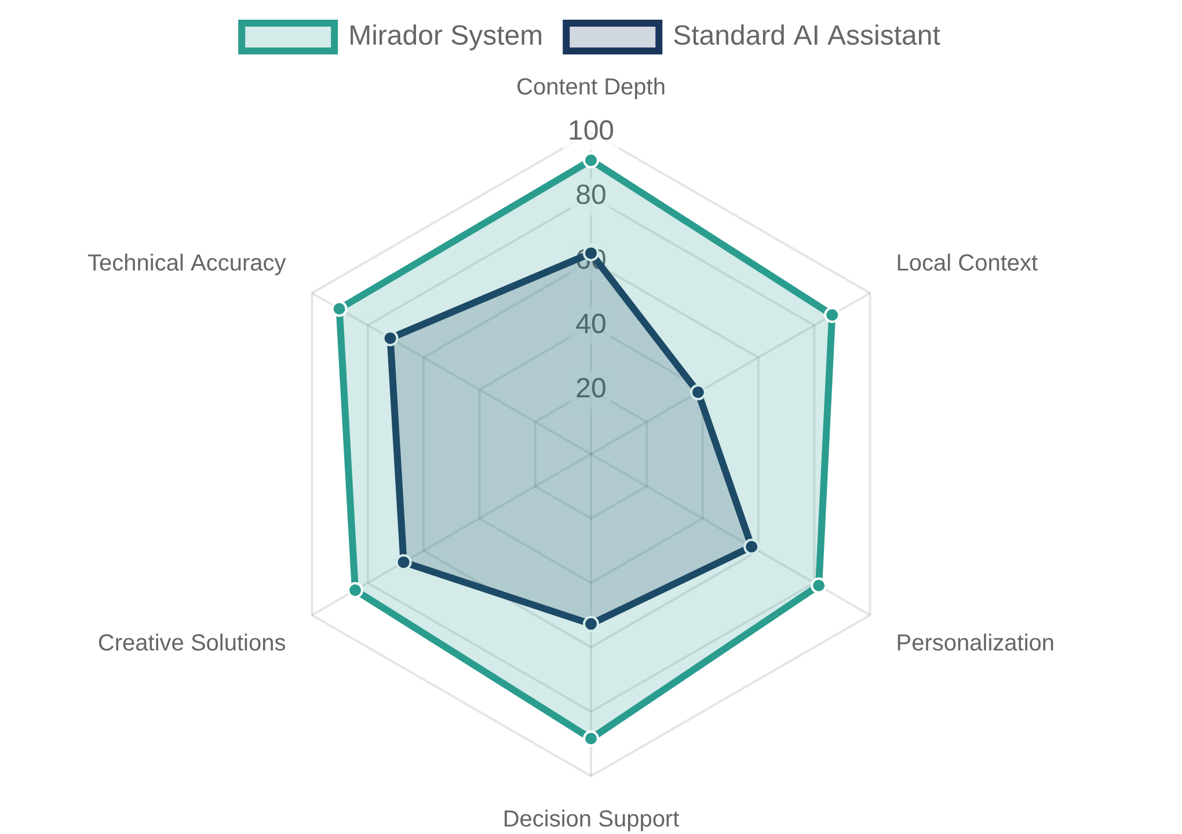



Key System Strengths
Mirador consistently produces
that approaches professional consulting standards across multiple domains.
high-quality content
Content Quality and Analytical Depth
Comprehensive financial planning, career development analysis, and personal decision-making support with structured matrices
Louisville-Specific Expertise
Genuine local context integration with regional economic conditions, cultural factors, and community resources
Originality and Creative Problem-Solving
Innovative solutions that go beyond conventional wisdom, with distinctive voice development and creative storytelling
Technical Implementation Sophistication
Mirador's performance across key capability dimensions compared to standard AI assistants
Professional-level software design with optimized model configurations and comprehensive output management

Slide 4


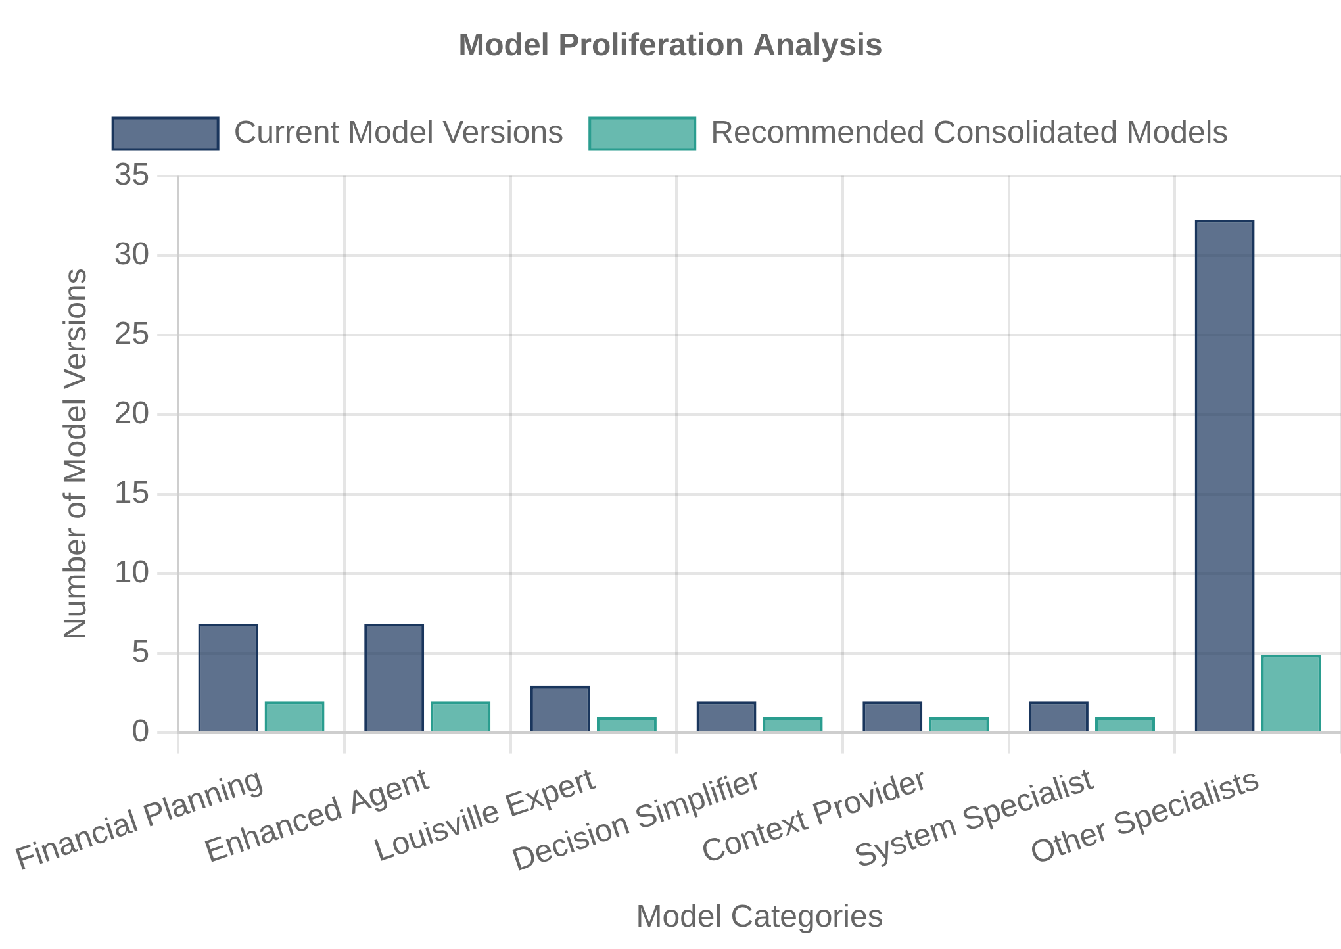



Critical Optimization Opportunities
The most significant challenges facing Mirador require
strategic intervention
to unlock the system's full potential.
Model Proliferation Complexity
56+ models with unclear deprecation policies, version management challenges, and base model inconsistency between
llama3.2
and
llama3.2_balanced
Performance Limitations
Sequential processing architecture with 1-2 minute execution times for complex chains, ~4.5GB memory usage at peak, and context window management constraints
Integration Deficiencies
Limited external data integration with financial accounts, calendar systems, and local data sources, with reliance on manual execution
Quality Assurance Gaps
Model proliferation by category showing version fragmentation and consolidation opportunity
Lack of systematic validation for recommendation accuracy, fact-checking, and consistency across analysis sessions

Slide 5
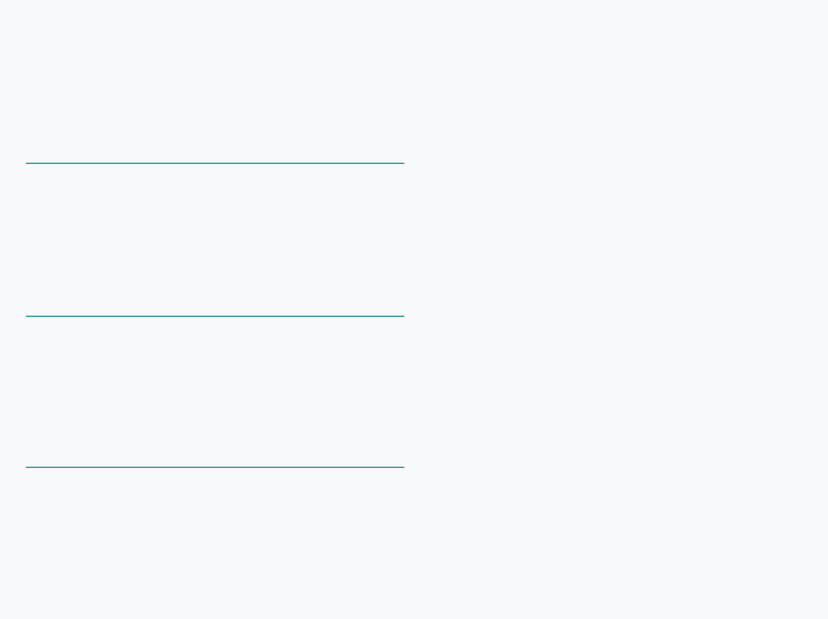

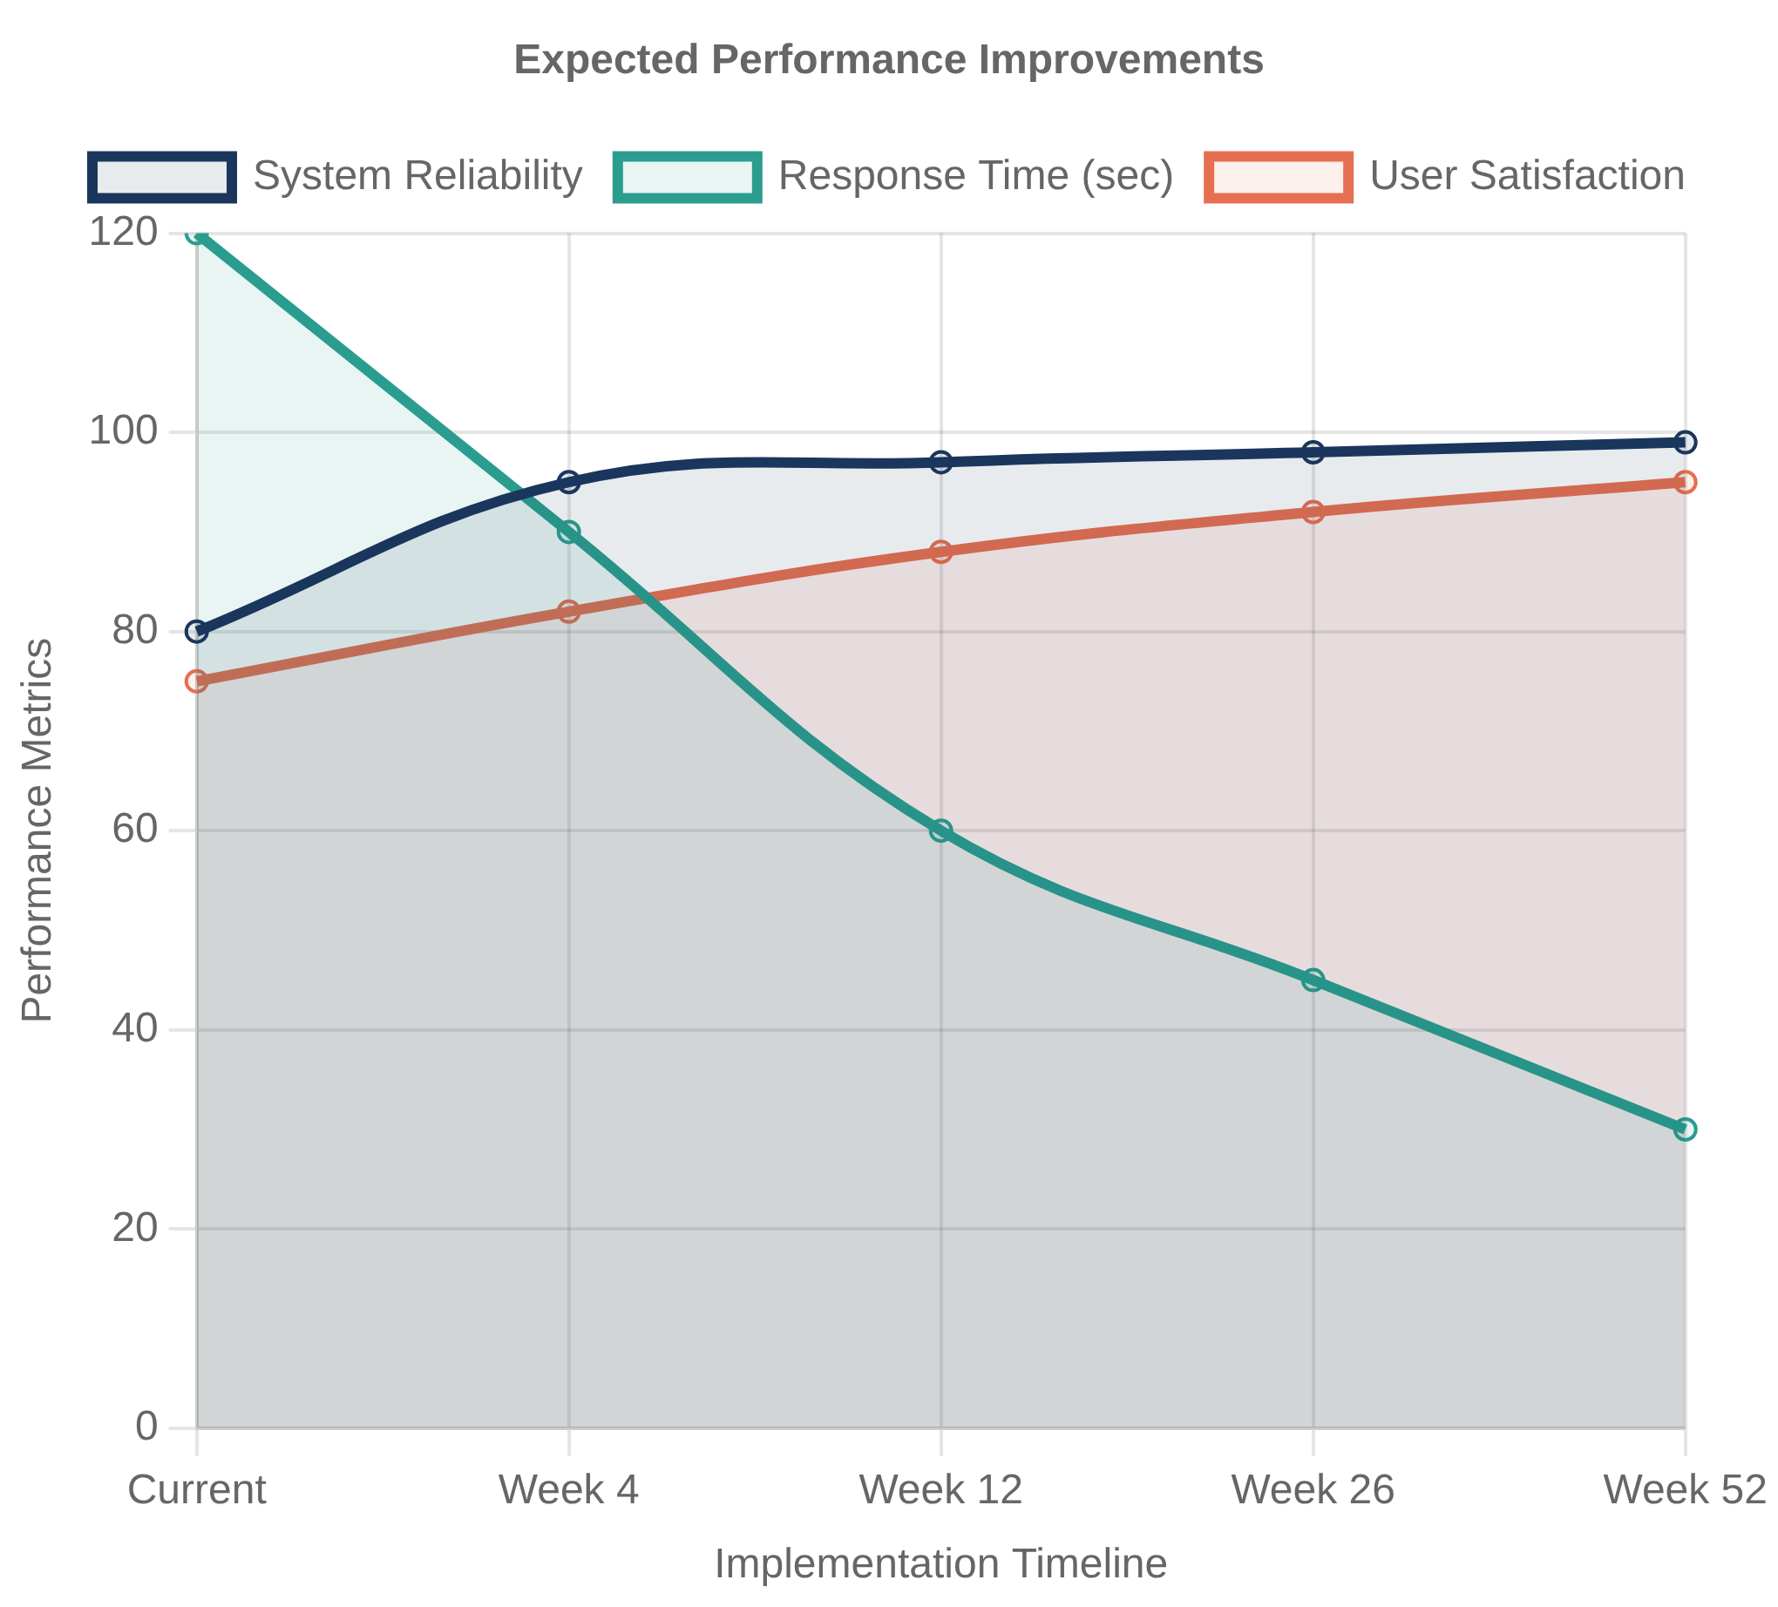








Strategic Recommendations
A phased approach to
will transform Mirador from prototype to production-ready platform.
strategic optimization
Immediate Technical Optimizations (2-4 Weeks)
Model Base Migration: Transition all specialists from
llama3.2
to
llama3.2_balanced
Model Consolidation: Reduce from 56+ models to 12-15 optimized specialists
Medium-Term System Enhancement (1-3 Months)
Parallel Processing: Enable concurrent execution of independent analysis components
External Data Integration: Connect to financial APIs, local news feeds, and calendar systems
Long-Term Strategic Enhancement (3-12 Months)
Quality Assurance System: Implement automated validation and content quality metrics
Implementation timeline with expected performance improvements at each phase
Multi-User Capabilities: Enable family or team usage scenarios with personalization

Slide 6

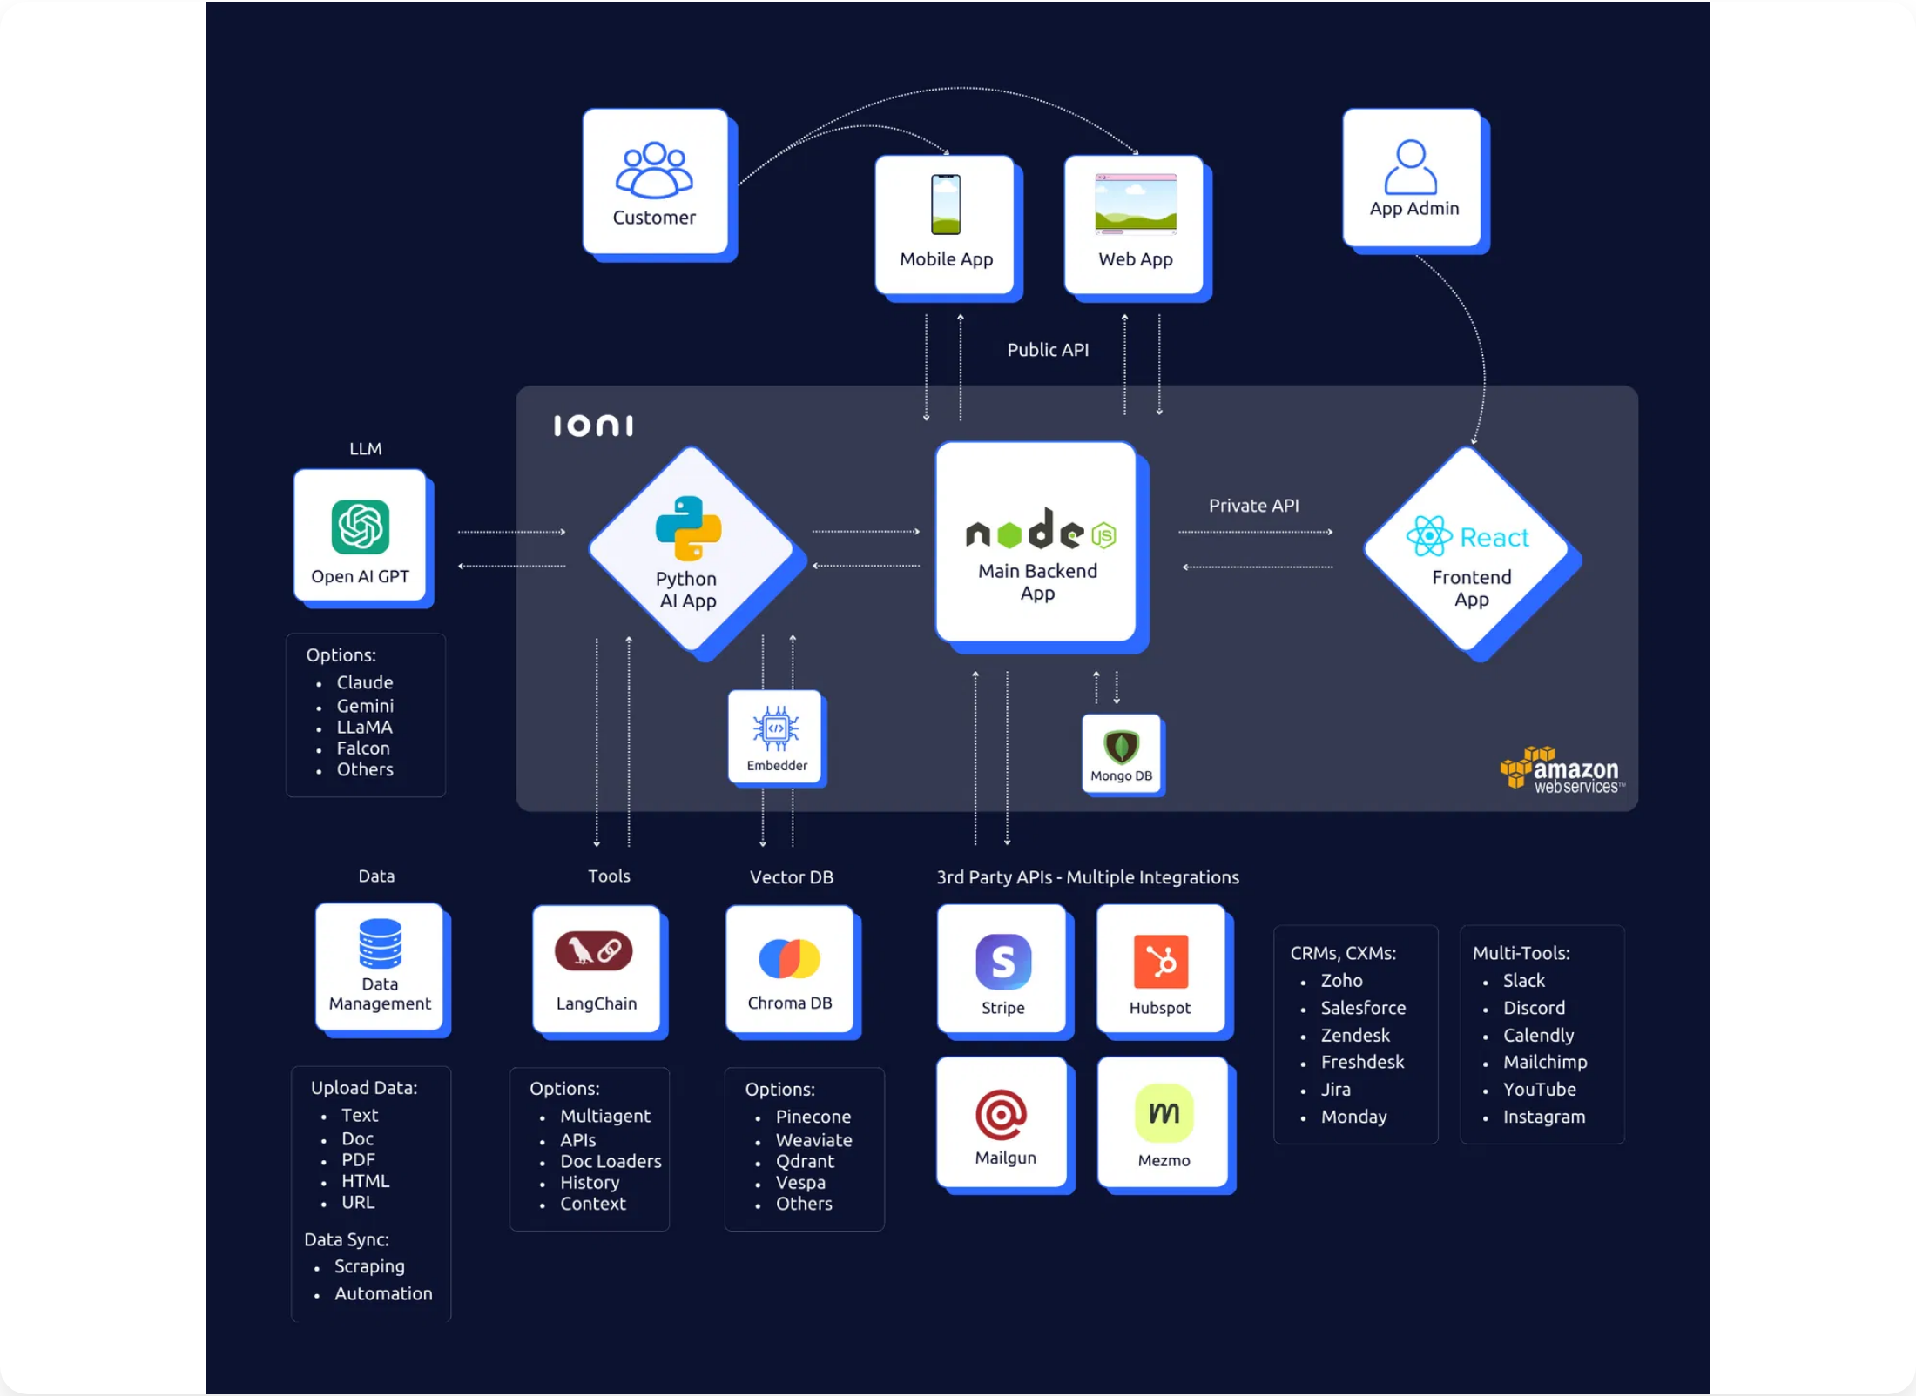









Implementation Roadmap
A
ensures systematic optimization while maintaining system availability.
phased implementation approach
1
Foundation Optimization
Weeks 1-4
System reliability improvement to >95%
Model library reduction by 60-70%
Comprehensive monitoring implementation
2
Performance and Integration
Weeks 5-12
Execution time reduction by 30-50%
Integration with 3-5 external data sources
Automation of routine analysis tasks
3
Advanced Capabilities
Weeks 13-52
Systematic implementation approach ensures continuous improvement while maintaining system availability
Quality validation accuracy >95%
Support for 5+ concurrent users
Predictive insight accuracy >80%

Slide 7



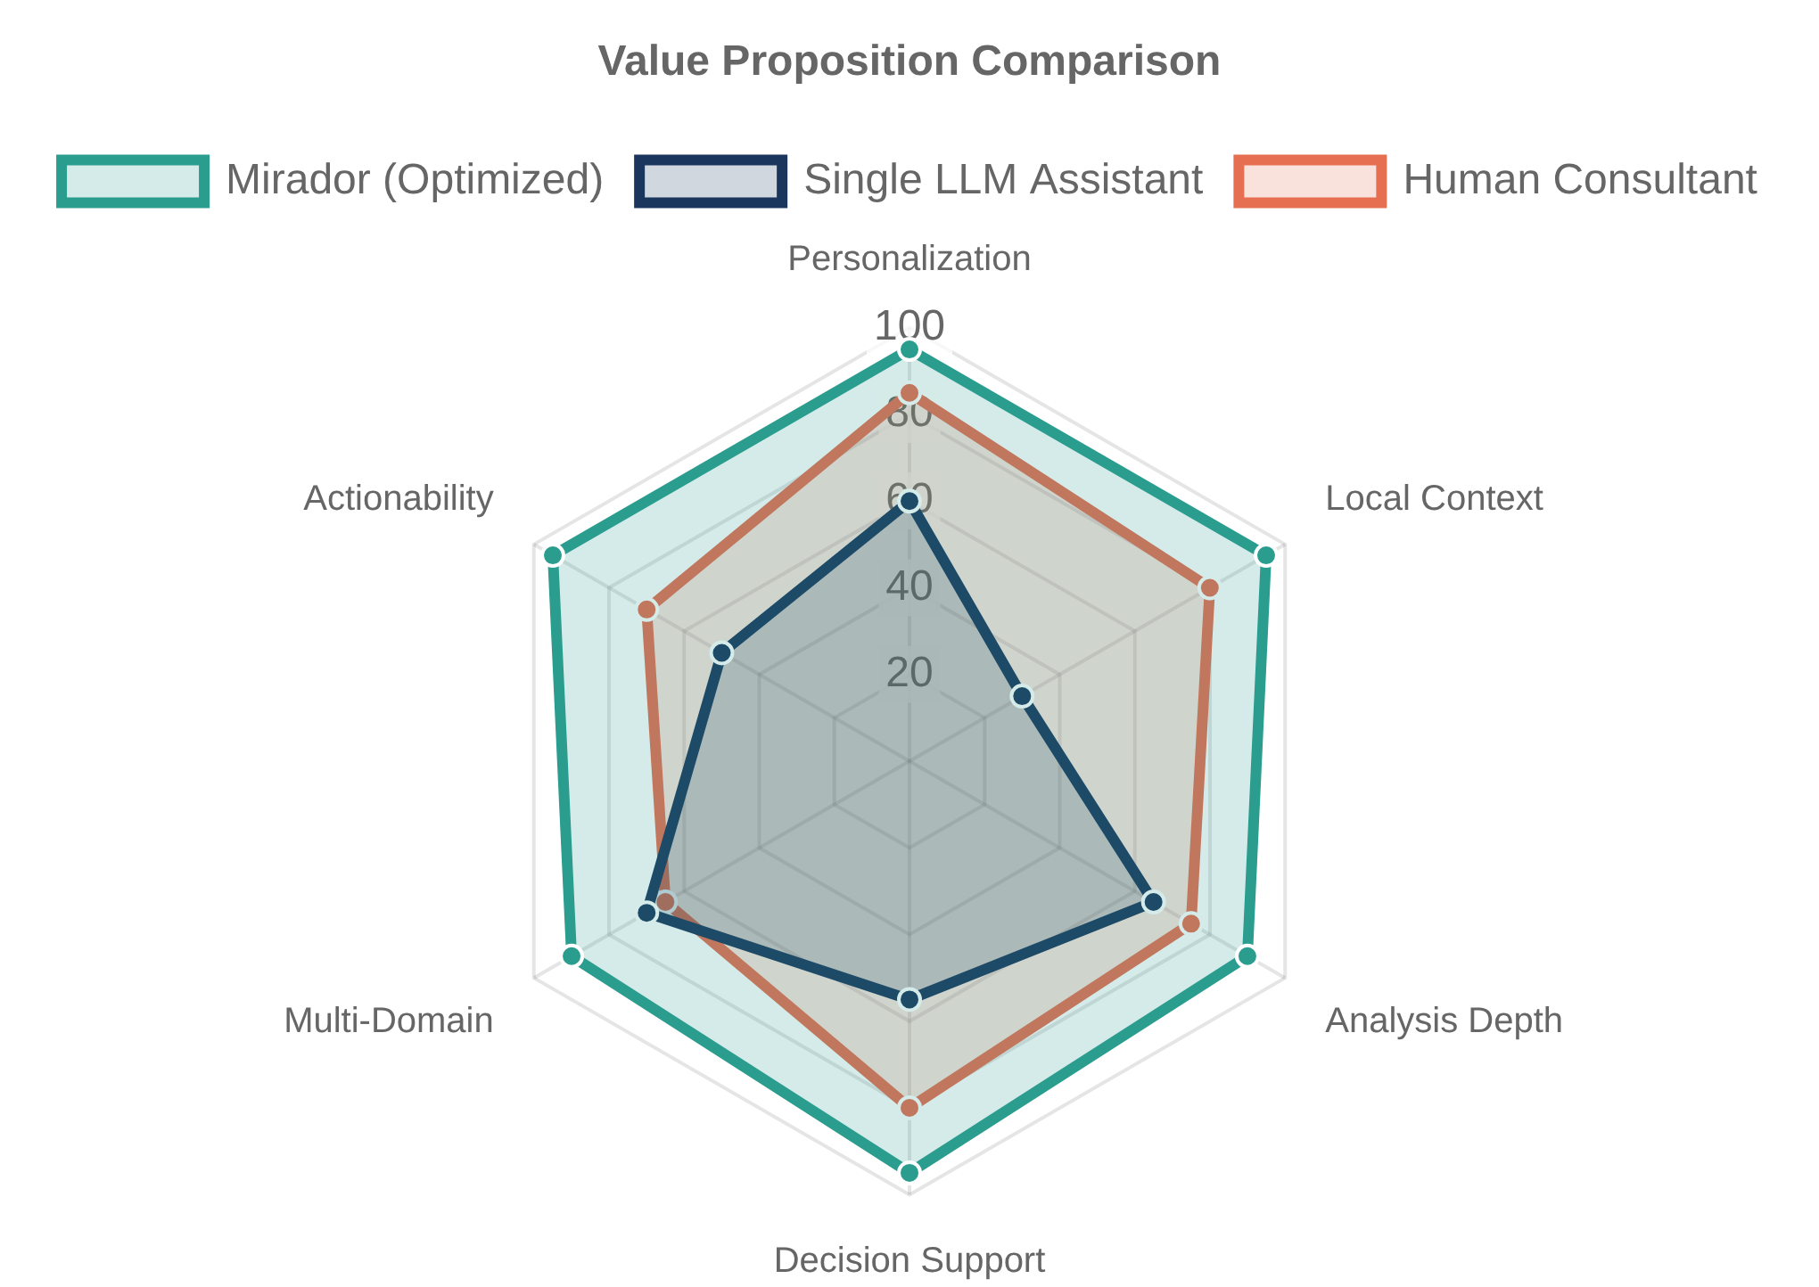

Strategic Vision and Conclusion
The Mirador multi-agent AI orchestration system represents a
remarkable achievement
in personal AI assistance that demonstrates the transformative potential of collaborative artificial intelligence.
Strategic Vision
Transform Mirador from impressive prototype to robust, user-friendly platform for personal AI orchestration
Establish new model of human-AI collaboration that enhances rather than replaces human decision-making
Contribute valuable insights to AI community regarding multi-agent orchestration and personalization
Key Differentiators
Sophisticated multi-agent orchestration with progressive context building
Louisville-specific expertise integration with genuine local context
Comprehensive analysis capabilities across financial, career, and personal domains
Mirador's value proposition compared to alternative AI assistance approaches
Final Assessment
Through systematic implementation of the recommended optimizations, Mirador can achieve its vision of serving as a comprehensive personal life optimization platform that provides daily value, strategic guidance, and long-term decision support.

